Slide 1


Semantic Content Infrastructure
for Knowledge Applications
Tools of Change 2011
Thane Kerner, CEO
Silverchair

Slide 2
1. Basics of Semantic Content
2. Dynamic Concept-Based Relationships
3. Semantically-Driven Behavioral Analysis
4. Application Ecosystem

Slide 3

N-Tier Basics

Slide 4
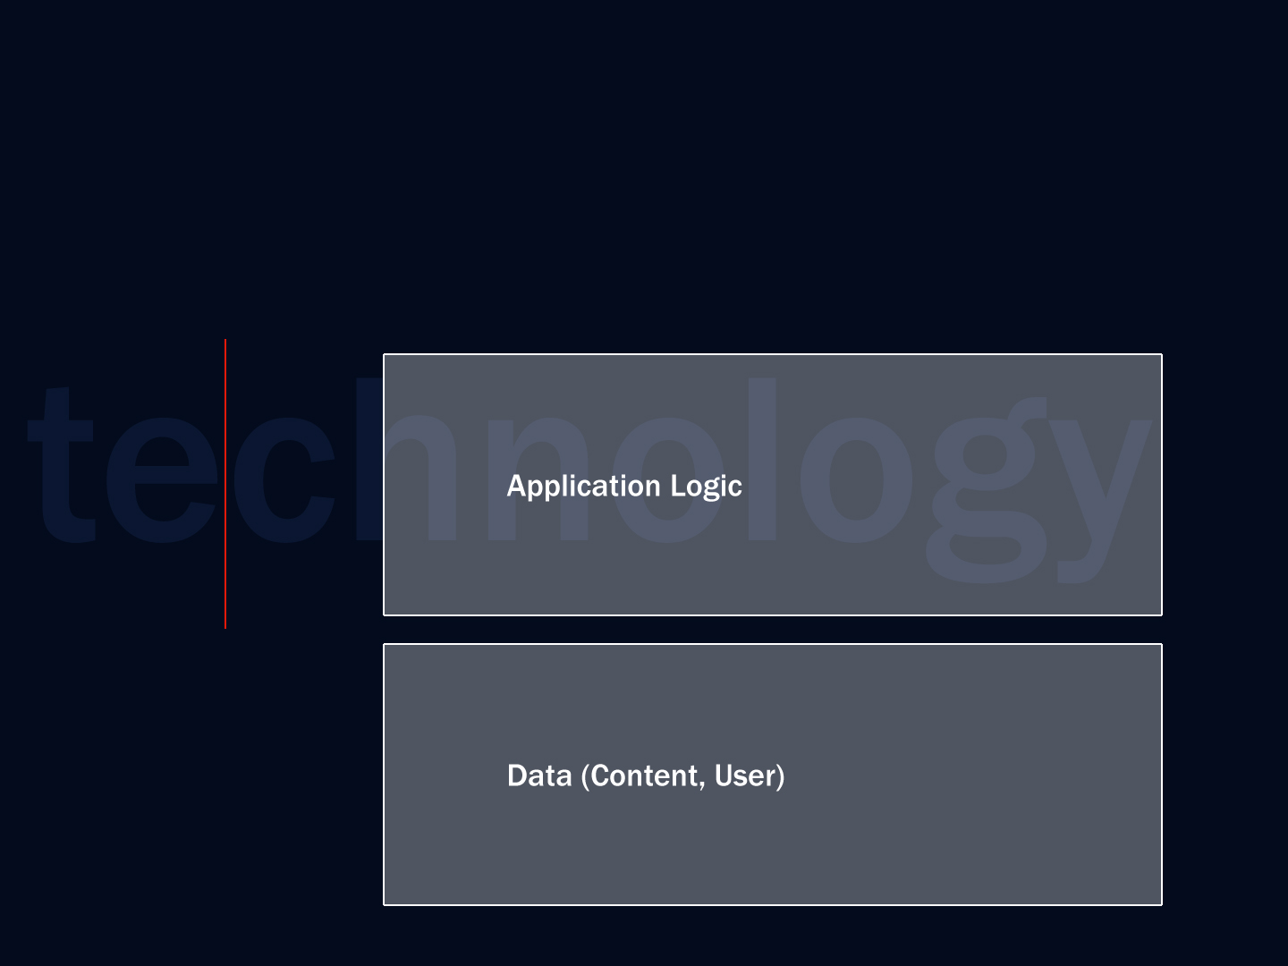
N-Tier Basics

Slide 5
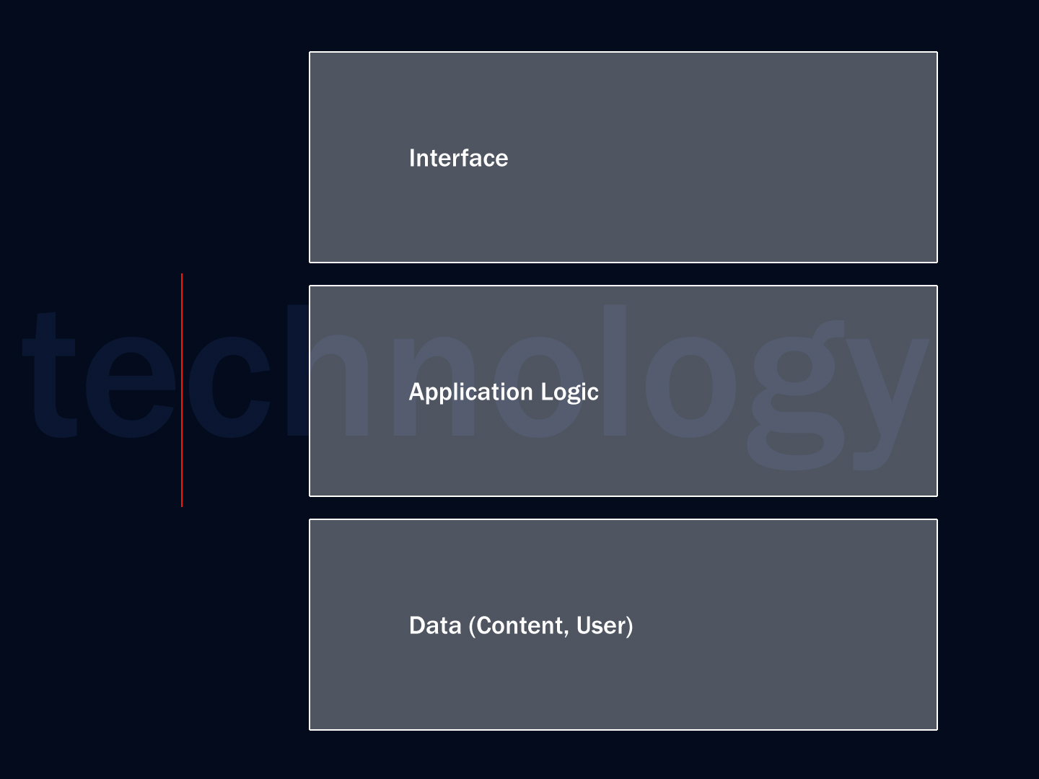
N-Tier Basics

Slide 6
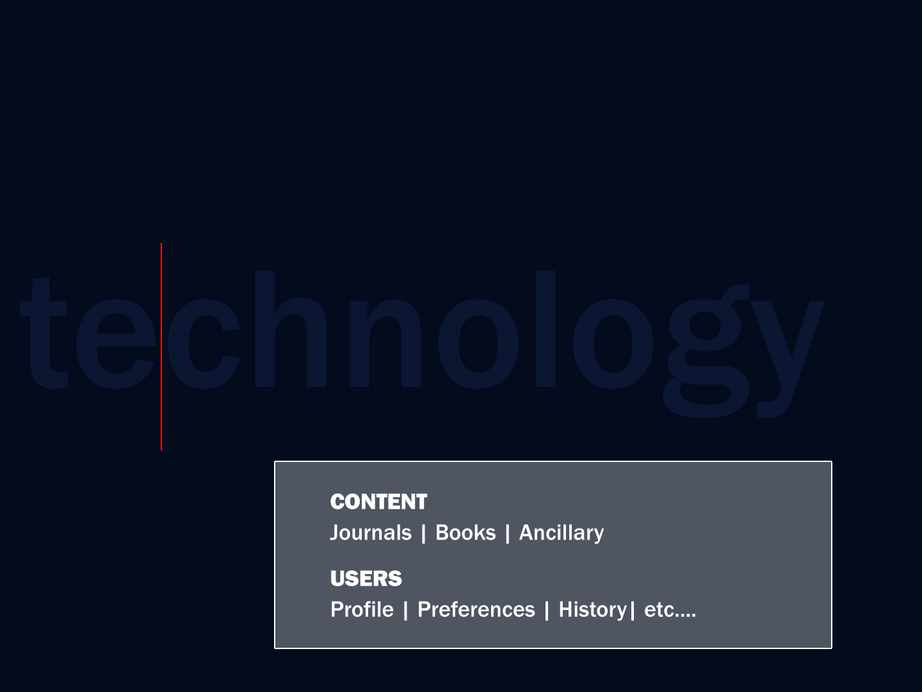
N-Tier
Publishing

Slide 7
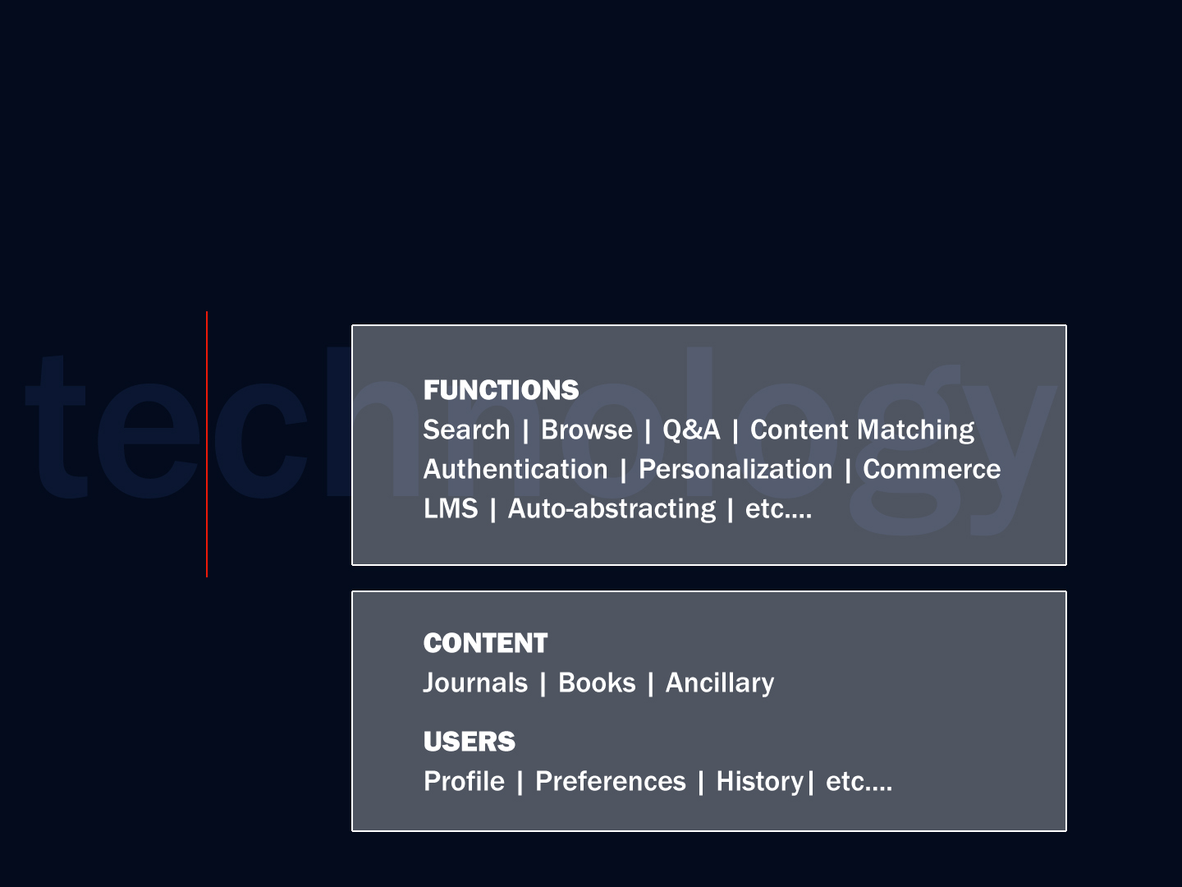
N-Tier
Publishing

Slide 8
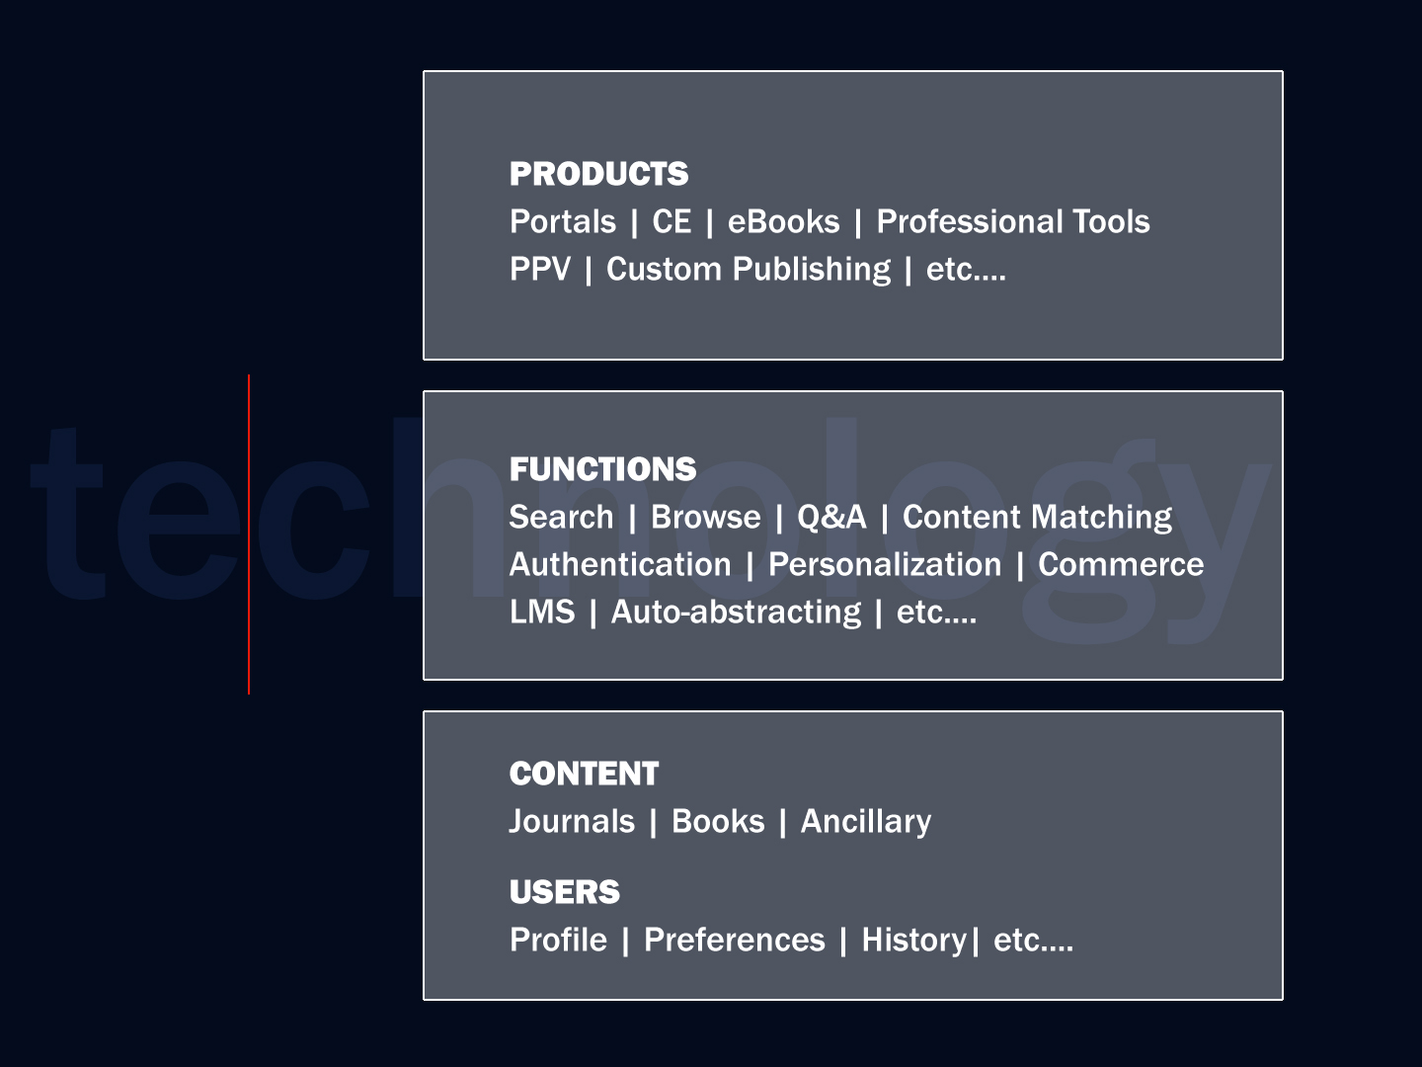
N-Tier
Publishing

Slide 9


Slide 10
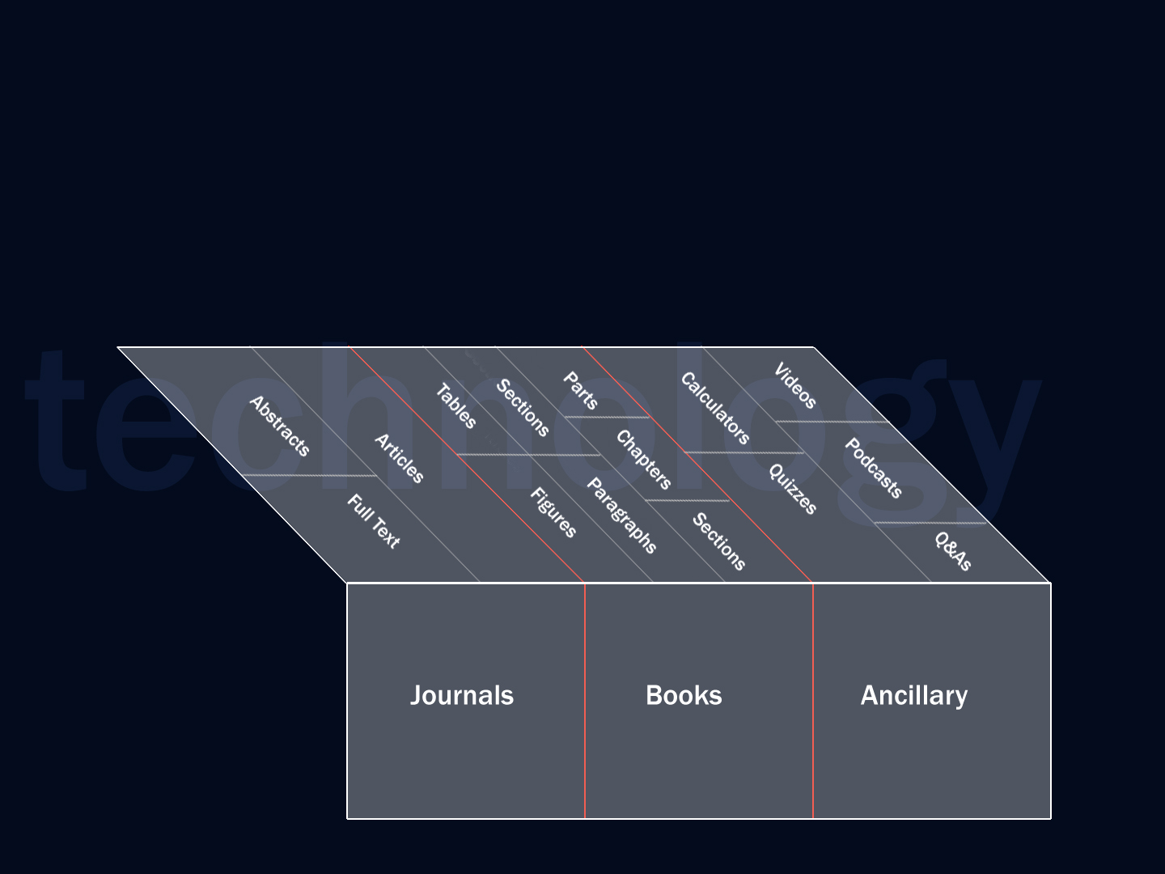

Slide 11
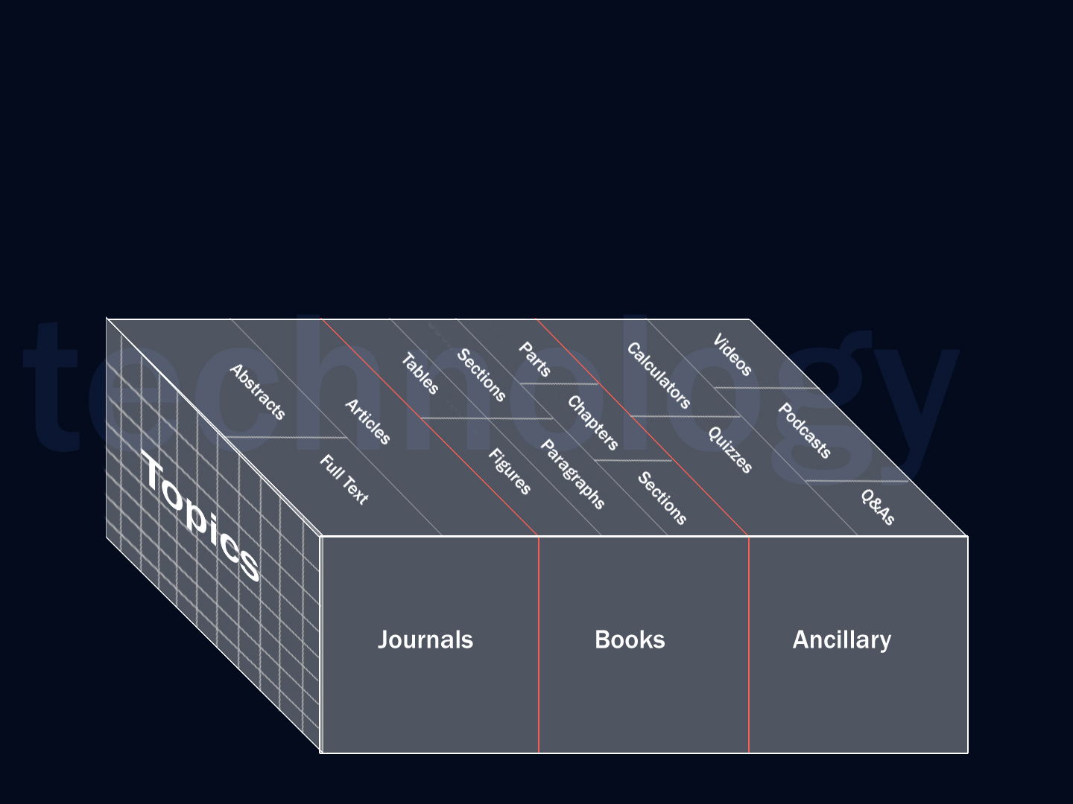

Slide 12
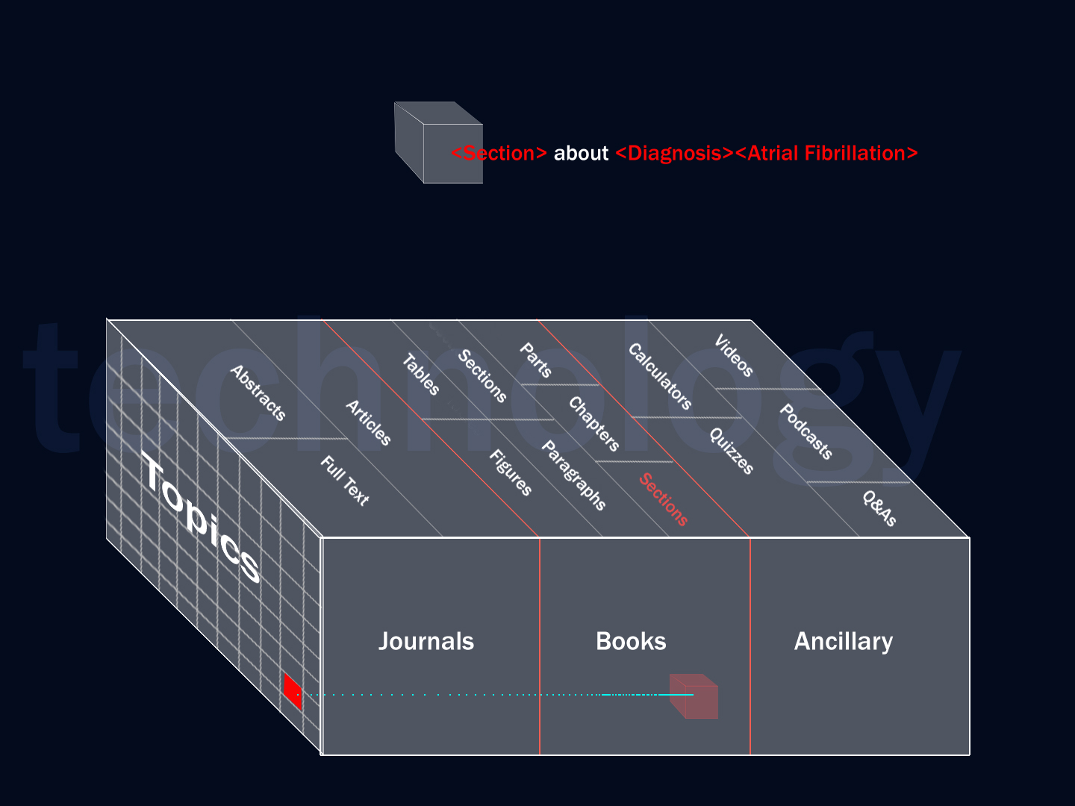

Slide 13
Taxonomic Normalization

Slide 14
For Humans
Chapter 23: Numbness, Tingling, and Sensory Loss
Normal somatic sensation reflects a continuous monitoring process,
little of which reaches consciousness under ordinary conditions.
By contrast, disordered sensation, particularly when experienced
as painful, is alarming and…
For Computers
<semantics controlvocab=“UMLS”>
<tag>
<root-term termID="28648">sensation disorders</root-term>…
“disordered sensation” = 215 PubMed results
“sensation disorders”
= 112,577 PubMed results

Slide 15
<title>
<topic=panic disorder>
<section>
<topic=therapy>
<author>
<abstract>
Granular
Semantic
Metadata
<reference>
<topic=evidence quality>

Slide 16
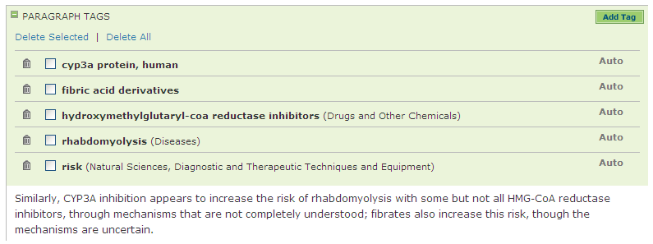
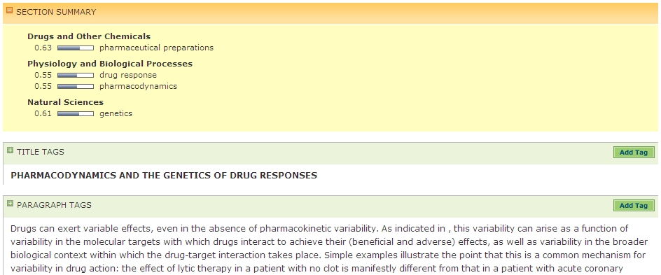

Slide 17
Dynamic
Concept-Based
Relationships

Slide 18
Ontological expression
<drug=rosiglitazone>
<is risk factor for>
<condition=myocardial infarction>

Slide 19
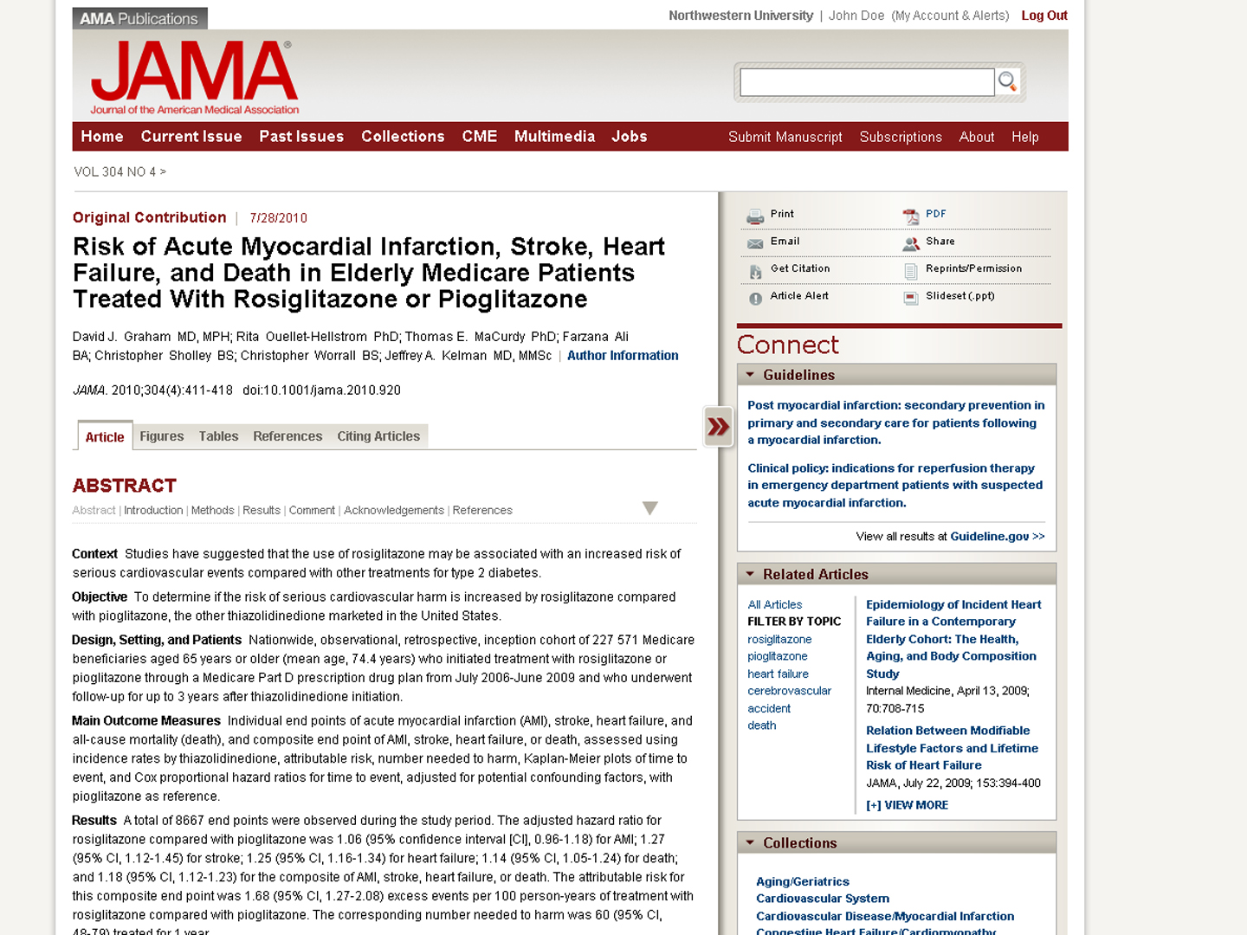

Slide 20
Behavioral Analysis to Improve Relevance

Slide 21
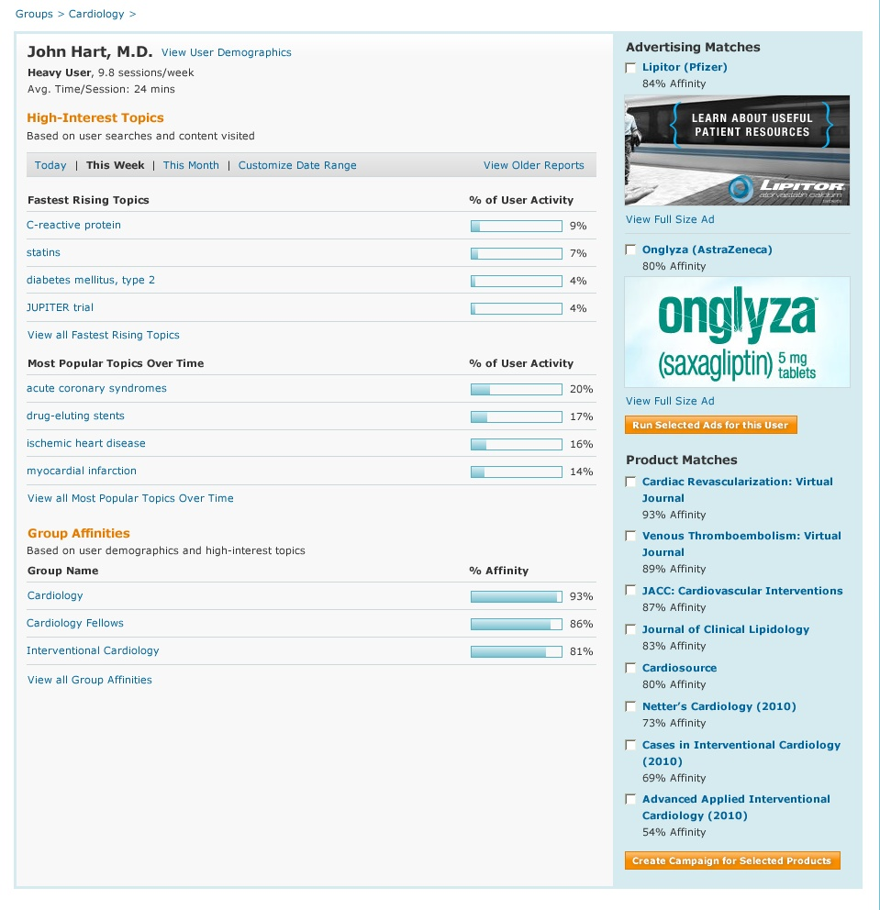
O6AE-9D3-F412

Slide 22
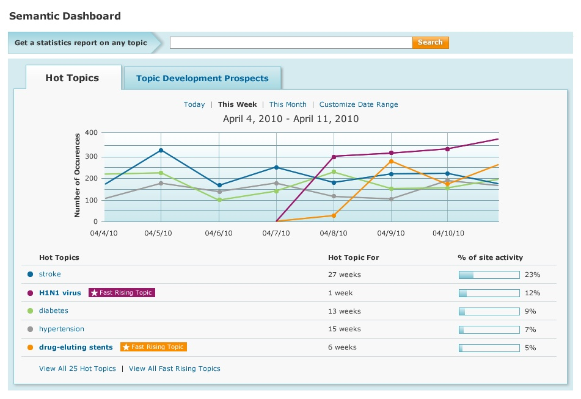

Slide 23
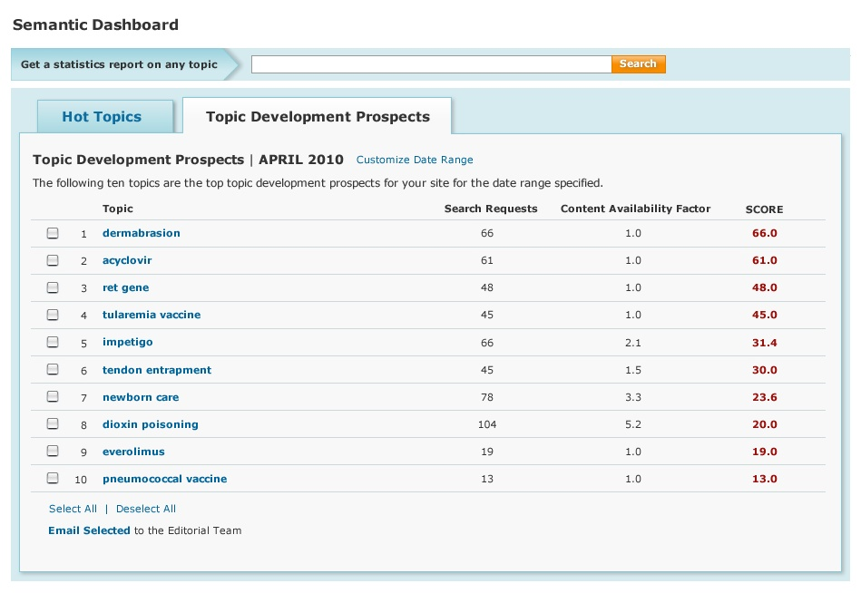

Slide 24
Application Ecosystem

Slide 25
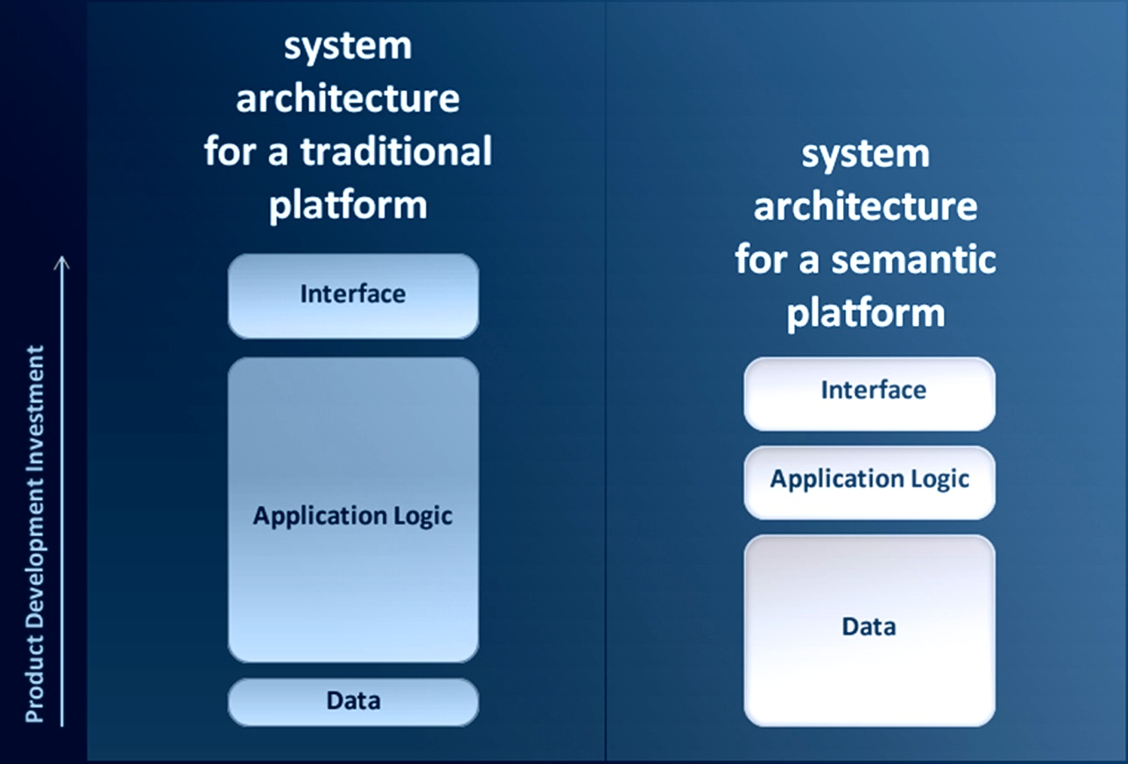

Slide 26
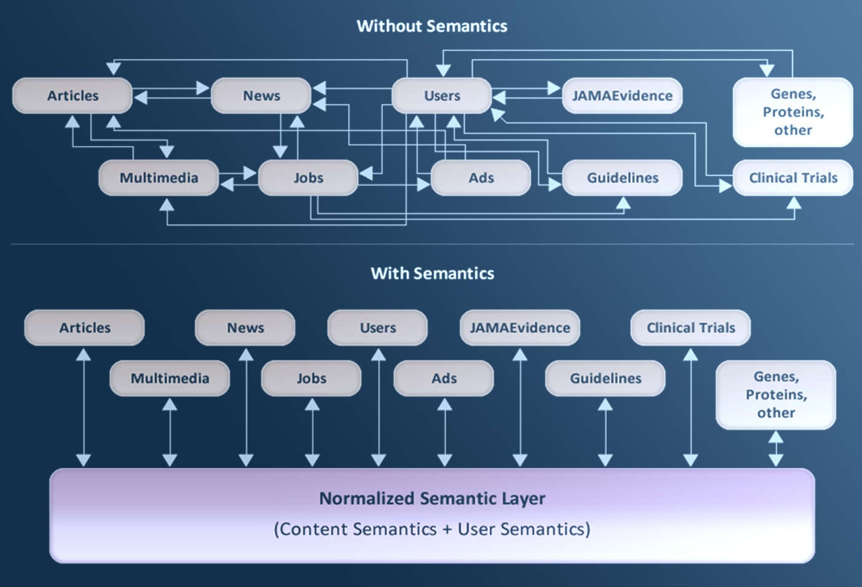

Slide 27
Production approach
“Here’s how we do that semantic thing.”
Application approach
“Here’s how we create a more useful and compelling service for our customers.”

Slide 28
Medical point of care
Health care
Accuracy Threshold
Professional Info / Research
Commoditization
Mistrust
Abandonment
Bad outcomes
Malpractice
Biz Comm (email, etc.)
General News
Relative Accuracy
Req’d
Shopping
Entertainment
Information Criticality

Slide 29
Taxonomic Approach
to Content Enrichment
Add a Domain-Aware Dimension to
Text Mining Techniques
Developed Technology Based on Domain…
      Language
      Relationships
      Processes and Use Cases

Slide 30
The Domain-Aware Approach
Knowledge Domain Abstraction (Taxonomy and Ontology)
Taxonomic Content Inputs
User
Inputs
Statistical
Text Mining
(NLP)
<optimal semantic metadata>

Slide 31
Scaled Content Enrichment
Taxonomy/Collections Management Group
Search query logs; user activity logs; content phrase analysis, taxonomy interaction analysis
User Behavior Inputs
Publisher Content Repository
Cortex Taxonomy
Hierarchical relationships
UMLS/standards mapping
Content gap analysis
+
Equivalents Server
Synonyms/Alt phrasing Acronyms/Jargon
Content Import/Export Integration Layer
Publisher Web Applications
+
Tagmaster Automated Tagging System
Vocabulary control
Custom Taxonomies
Custom collection mapping
Local/proprietary terms
Concept Identification
Significance Weighting
(Including Editorial Review & Validation)
Totem Taxonomy & Thesaurus Manager
XML Web Services
(Swiss Context Server)
Swiss SOAP XML API
Real-time query expansion/normalization; navigation; related concepts; etc.
Semantic Services Architecture

Slide 32
thanek@silverchair.com
Tools of Change 2011
Thane Kerner, CEO
Silverchair

